Slide 1
Lesson 5 – Collections Framework: Set, Map

Slide 2
Lesson goals
Use auto-extendable containers
distinct-values container
associative array

Slide 3
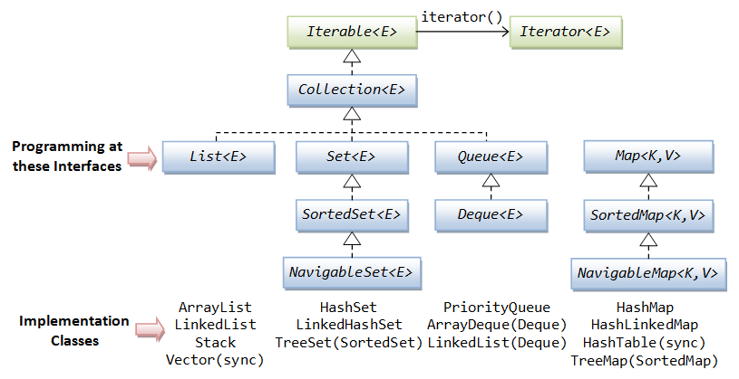
Collections Framework

Slide 4
Set
does not allow duplicates
HashSet, LinkedHashSet, TreeSet

Slide 5
HashSet
Backed by Hash table.
Exploits hashCode()method
adding elements takes constant time
existence check takes constant time
supports value ordering TreeSet
lost of insertion order

Slide 6
HashSet
Set<Integer> set = new HashSet<>(); set.add(1); // 1 set.add(2); // 1 2 set.add(1); // 1 2 set.contains(1); // true set.contains(3); // false set.remove(2); // 1

Slide 7
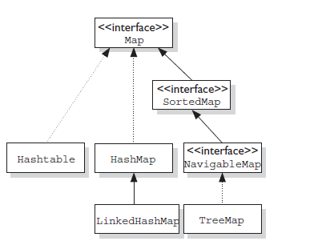
Map

Slide 8
Map
boolean isEmpty() int size()
boolean containsKey(Object key) boolean containsValue(Object) V get(Object key) V put(K key, V value) V remove(Object key) V putIfAbsent(K key, V value) V getOrDefault(Object key, V defaultValue)
void forEach(BiConsumer<? super K, ? super V> action)
Set<K> keySet() Collection<V> values()
…
Notes:
void clear();
merge(), void putAll(Map<? extends K, ? extends V> m)
Set<Map.Entry<K, V>> entrySet()
boolean equals(Object o)
int hashCode()
void replaceAll(BiFunction<? super K, ? super V, ? extends V> function)
boolean replace(K key, V oldValue, V newValue)
V computeIfPresent(K key, BiFunction<? super K, ? super V, ? extends V> remappingFunction)
V computeIfAbsent(K key, Function<? super K, ? extends V> mappingFunction)

Slide 9
Map
HashMap stores the keys in a hash table
adding elements takes constant time
existence check takes constant time
lost of insertion order
TreeMap stores the keys in a sorted tree structure
keys are always in sorted order.
adding and checking if a key is present are both O(log n).
LinkedHashMap…
Notes:
You use a map when you want to identify values by a key

Slide 10
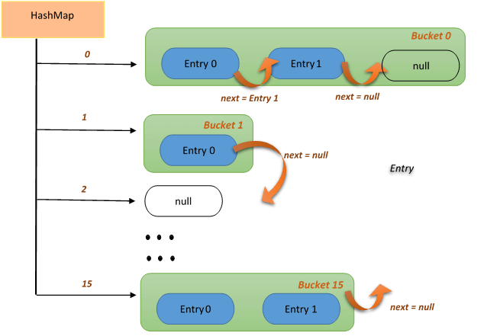
HashMap

Slide 11
HashMap
Map<String, String> map = new HashMap<>(); map.put("koala", "bamboo"); map.put("lion", "meat"); map.put("giraffe", "leaf"); for (Map.Entry<String, String> e : map.entrySet()) { println(e.getKey() + ":" + e.getValue()); // koala:bamboo giraffe:leaf lion:meat } map.forEach((key, value) -> { println(key + ":" + value); // koala:bamboo giraffe:leaf lion:meat });

Slide 12
Coding equals, hashCode and toString
print(1); print("Hello"); print(new Bird("Tweety")); print(new Bird("Tweety").hashCode()); print(new Bird("Tweety").equals(new Bird("Tweety")));

Slide 13
Coding equals, hashCode and toString
print(1); // 1 print("Hello"); // Hello print(new Bird("Tweety")); // Bird@6474c2 print(new Bird("Tweety").hashCode()); // 6583490 print(new Bird("Tweety").equals(new Bird("Tweety"))); // false

Slide 14
toString
class Bird { String name; public Bird(String name) { this.name = name; } @Override public String toString() { return name; } }
class Main { public static void main(String[] args) { System.out.println(new Bird("Tweety")); // Tweety } }

Slide 15
equals
class Bird { String name; public Bird(String name) { this.name = name; } @Override public boolean equals(Object o) { if (this == o)
return true; if (o == null || getClass() != o.getClass())
return false; Bird bird = (Bird) o; return Objects.equals(name, bird.name); } }

Slide 16
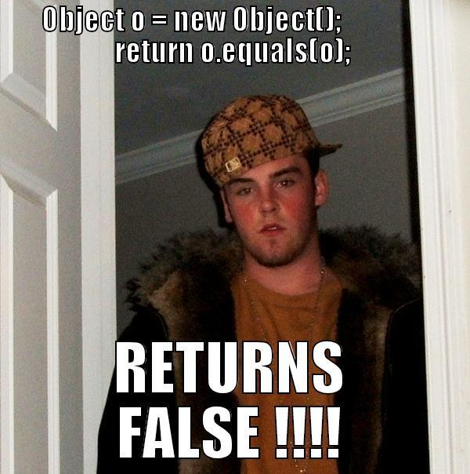
equals

Slide 17
equals - rules
Reflexive: for any non‐null reference value x, x.equals(x) should return true;
Symmetric: for any non‐null reference values x and y, x.equals(y) should return true if and only if y.equals(x) returns true;
Transitive: For any non‐null reference values x, y, and z, if x.equals(y) returns true and y.equals(z) returns true, then x.equals(z) should return true;
Consistent: For any non‐null reference values x and y, multiple invocations of x.equals(y) consistently return true or consistently return false, provided no information used in equals comparisons on the objects is modified;
For any non‐null reference value x, x.equals(null) should return false

Slide 18
equals - what is wrong
@Override
public boolean equals(Bird obj) { if (obj == null) { return false; } return this.name == obj.name; }
Notes:
Compilation fail

Slide 19
equals - what is wrong
@Override
public boolean equals(Bird obj) { if (obj == null) { return false; } return this.name == obj.name; }
Notes:
Compilation fail

Slide 20
hashCode
Whenever you override equals(), you must override hashCode()
Within the same program, the result of hashCode() must not change
If equals() returns true when called with two objects, calling hashCode() on each of those objects must return the same result.
If equals() returns false when called with two objects, calling hashCode() on each of those objects may return the same result.
Notes:
A hash code is a number that puts instances of a class into a finite number of categories.

Slide 21
hashCode
class Bird { String name; public Bird(String name) { this.name = name; } @Override public int hashCode() { return Objects.hash(name); } }

Slide 22
equals, hashCode and toString combination
class Bird { private final String name; public Bird(String name) { this.name = name; } @Override public String toString() { return "Bird{" + "name=" + name + '}'; } @Override public boolean equals(Object o) { if (this == o) { return true; } if (o == null || getClass() != o.getClass()){ return false; } Bird bird = (Bird) o; return Objects.equals(name, bird.name); } @Override public int hashCode() { return Objects.hash(name); } }

Slide 23
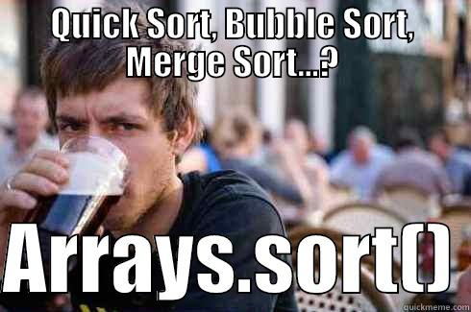
Collections class

Slide 24
Collections class
<T extends Comparable> T max(Collection<? extends T> coll); <T extends Comparable> T min(Collection<? extends T> coll); void reverse(List<?> list); void shuffle(List<?> list); <T> void copy(List<? super T> dest, List<? extends T> src); <T> List<T> synchronizedList(List<T> list); <T extends Comparable<? super T>> void sort(List<T> list); <T> void sort(List<T> list, Comparator<? super T> c);
<T extends Comparable> int binarySearch(List<? extends Comparable<? super T>> list, T key);

Slide 25
Comparable
class Animal { String name; Integer strength; // constructor
}
List<Animal> animals = new ArrayList<>(); animals.add(new Animal("cat", 3)); animals.add(new Animal("dog", 2)); animals.add(new Animal("elephant", 45));
Collections.sort(animals); // fails to compile
for (Animal animal : animals) { println(animal.getname()); }

Slide 26
Comparable
public interface Comparable<T> { int compareTo(T o); }
Zero is returned when the current object is equal to the argument to compareTo().
A number less than zero is returned when the current object is smaller than the argument to compareTo().
A number greater than zero is returned when the current object is larger than the argument to compareTo()

Slide 27
Comparable
class Animal implements Comparable<Animal> { String name; Integer strength; // constructor @Override public int compareTo(Animal other){ return name.compareTo(other.name); } }
List<Animal> animals = new ArrayList<>(); animals.add(new Animal("cat", 3)); animals.add(new Animal("dog", 2)); animals.add(new Animal("elephant", 45));
Collections.sort(animals);
animals.forEach(System.out::print); // cat dog elephant

Slide 28
Comparator
public interface Comparator<T> { int compare(T o1, T o2); }
Zero is returned when the arguments of compare() methods are equal.
A number less than zero is returned when the first argument is smaller than the second argument to compare()
A number greater than zero is returned when the first argument is greater than the second argument to compare()

Slide 29
Comparator
class Animal { String name; Integer strength; // constructor }
Comparator<Animal> animalComparatorByStrength = new Comparator<>() { @Override public int compare(Animal o1, Animal o2) { return o1.strength.compareTo(o2.strength); } }
List<Animal> animals = new ArrayList<>(); animals.add(new Animal("cat", 3)); animals.add(new Animal("dog", 2)); animals.add(new Animal("elephant", 45));
Collections.sort(animals, animalComparatorByStrength);
animals.forEach(System.out::print); // dog cat elephant

Slide 30
Homework
Clean Code: A Handbook of Agile Software Craftsmanship by Robert C. Martin : Chapter 4-6
Update Morse codec to store fixed alphabet mappings (Morse) as Map;
Implement analytics in org.geekhub.crypto.analytics.CodingAudit:
Count words repetitions across all encoding inputs in descending order.
Count operations done per day.
Find the algorithm used the most times.

Slide 31
Homework
Find the fastest implementations across:
ArrayList vs LinkedList: get/add/remove/set values in the beginning/middle/end;
HashSet vs LinkedHashSet vs TreeSet: add/remove/contains values in non-empty;
HashMap vs LinkedHashMap vs TreeMap: add/removal/update/contains in non-empty;

Slide 32
Links
Collections
Java Collections Cheat Sheet

Slide 33
Thanks!
Any Questions?
Or find us in Slack:
@Yaroslav Brahinets
@Vasya Rudas
@Oleksandr Kucher

